Slide 1
Introducing a dealership controlled lead generator.
This product allows you to supply shoppers with a current credit score and financial tools.
You get:
An Exclusive shopper with a credit score and a 25-line item summery.
Visit https://www.scorenavigator.com/affiliateauto to register your company
NEXT

Slide 2
Agent Dashboard
Track Members Enrolled
Purchase Redemption Codes
Referral Link for Enrollments
Banners and Videos for Advertising
2

Slide 3
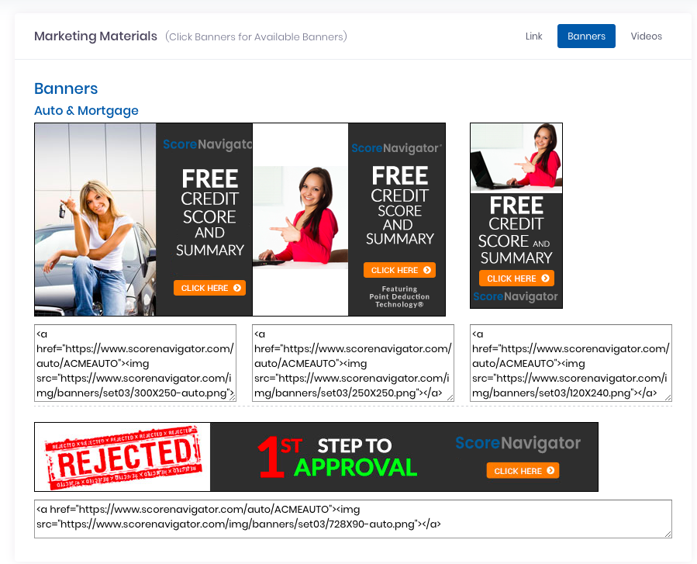
Marketing Tools
Located inside of the dashboard, marketing materials such as videos and banners are available
3

Slide 4
Redemption Codes
You control pricing and volume. By purchasing codes the shopper clicks your advertised link and goes to the enrollment page the built-in code allows them to bypass putting in payment information
4

Slide 5
Redemption Codes
Here you will enter your credit card details to purchase the codes for your account.
You may add more codes as you need them.
5

Slide 6
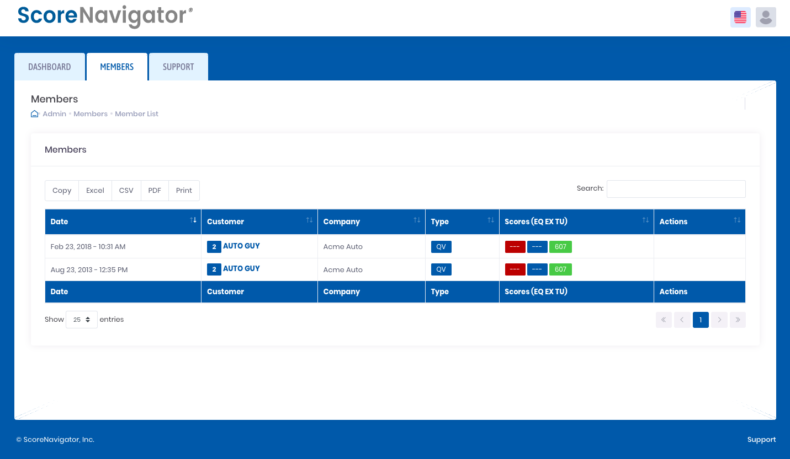
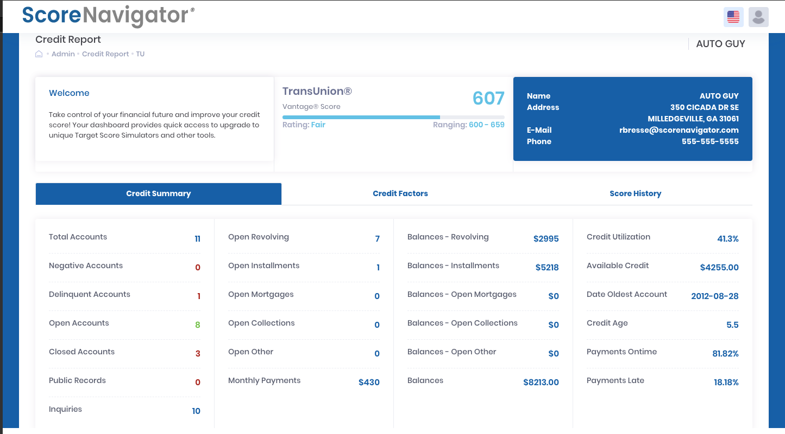
Members Section
Members Contract Information Provided
Current TransUnion Score is Presented
25 Item Credit Summery
Factor Codes
Score History
6

Slide 7
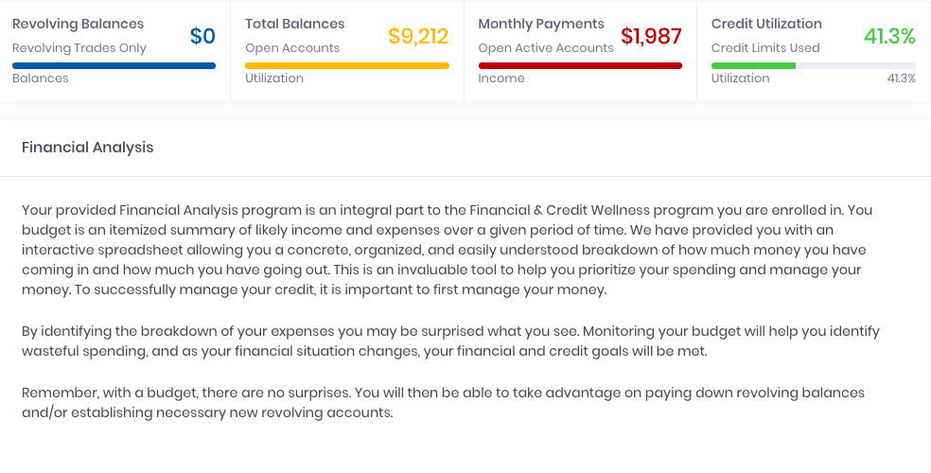
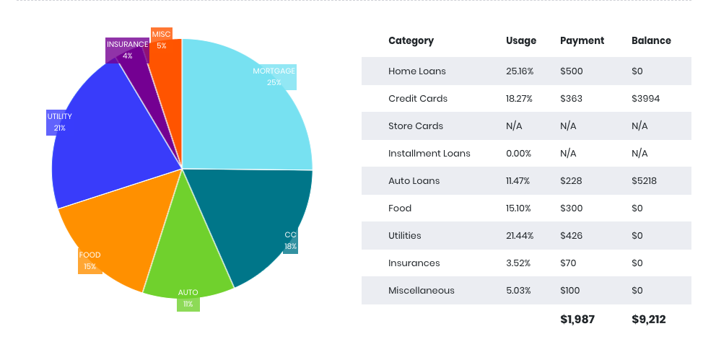
Members Benefits
Members are provided with a complete financial section with financial analysis, and budgeting programs for viewing. This will allow you to see the members financial situation from their budget sheet.
7

Slide 8
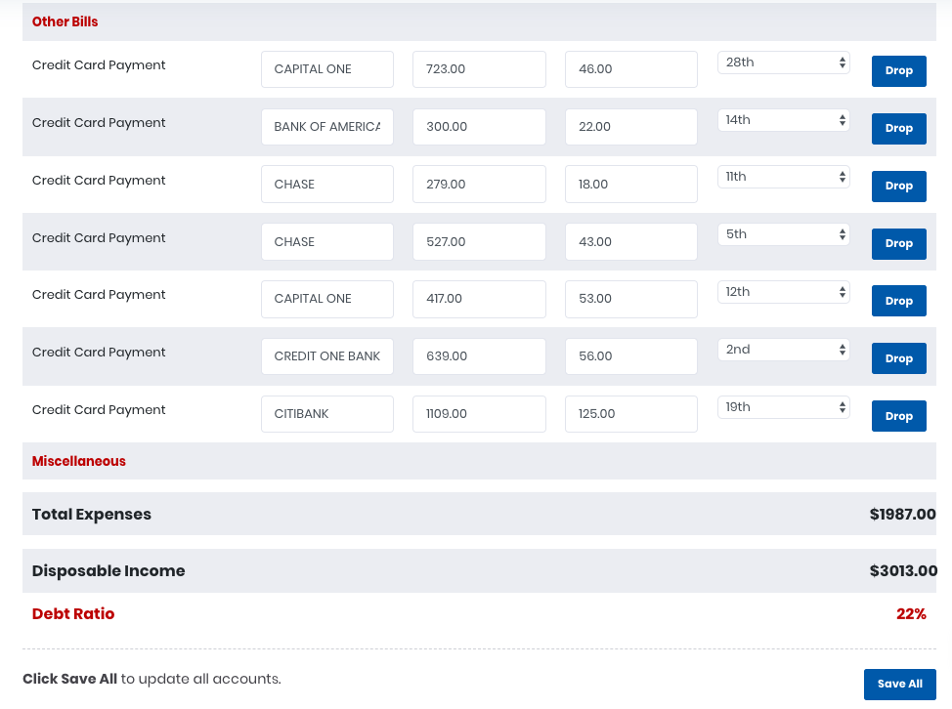
Budget Sheet
Members fill out a budget sheet. You will be able to see their income, expenses and disposable income.
8

Slide 9
Support FAQs
Members are also provided with a support section. This section allows members to have access to valuable information on credit as well as finance
9

Slide 10
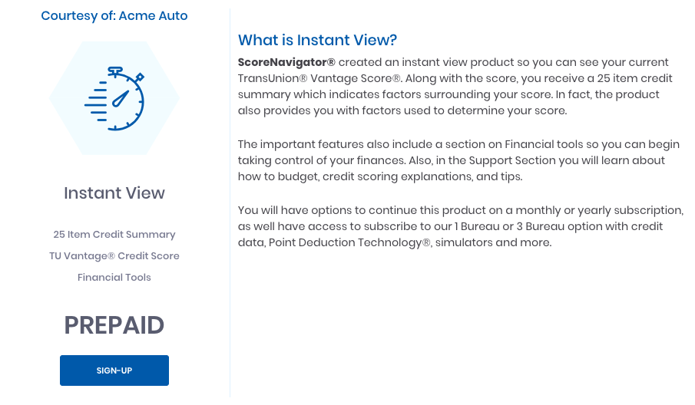
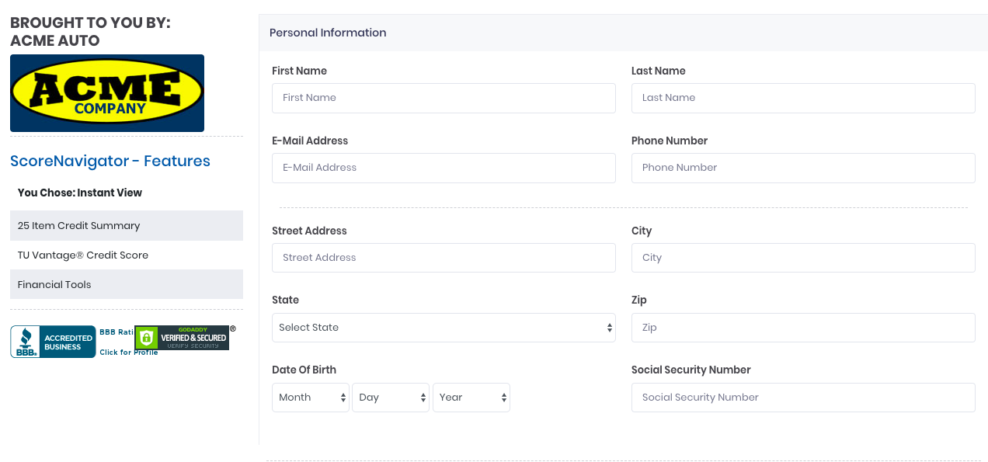
How To Enroll
Once the shopper clicks the link you advertise it will take them to a branded enrollment page. The enrollment gives the member access for 30 days. The dealership has unlimited access to the members information.
10

